Slide 1
Visualization Project : Hospital Information Technology Capacity(HIT)
NAME: Shang-Yung Hsu (Tommy)
Guannan Cui (Gary)

Slide 2
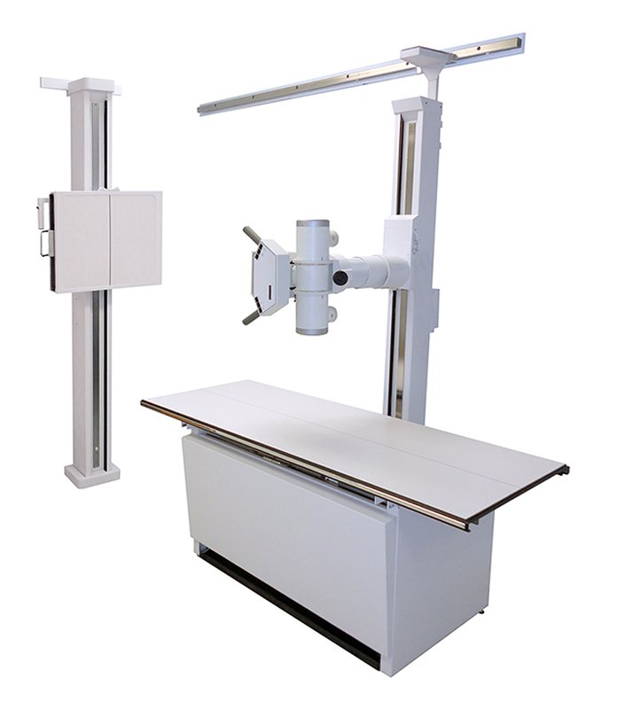


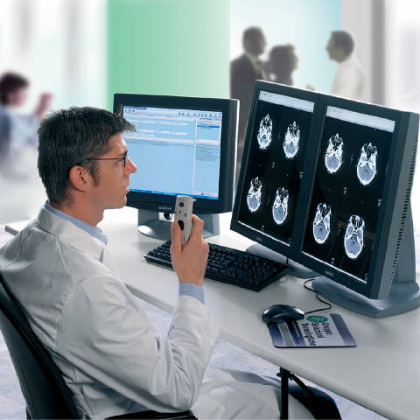
Problem definition
……….
HIT is defined as a measurement on all equipment in a hospital.

Slide 3
Algorithm design
Step 1: Calculate all correlation numbers between hospital equipment(or system) and health care quality.
Step 2: Change all the correlation numbers to distance.
(Distance = the inverse number of the absolute of correlation value)
Step 3: Calculate the angle for every point. Each point means different equipment.
Step 4: Use the angle and the distance to determine every point.
Step 5: Build a slider to change R(distance) to show different range of point.
Step 6: Show equipment name and accurate correlation number when cursor move to the point.

Slide 4


Algorithm design
Correlation < 0 Correlation > 0
Flag = 1 // means <0
Count_N ++
Corr = 1/absolute(corr) // change to distance
Angle_N = 180/Count_N+1
Angle_Ni = Angle_Ni – Angle_N
X = Corr + Sin(Angle_Ni )
Y = Corr + Cos(Angle_Ni)
Draw_Point(x,y)
Flag = 0 // means >0
Count_P ++
Corr = 1/absolute(corr)//
change to distance
Angle_P = 180/Count_N+1
Angle_Pi = Angle_Pi + Angle_P
X = Corr + Sin(Angle_Pi )
Y = Corr + Cos(Angle_Pi)
Draw_Point(x,y)

Slide 5
Description of Database
1. First line of the data( EX: Cardiology – Cath Lab) means the name of equipment
2. Every number means different hospitals
3. “1” means hospital has the equipment, “0” means not

Slide 6
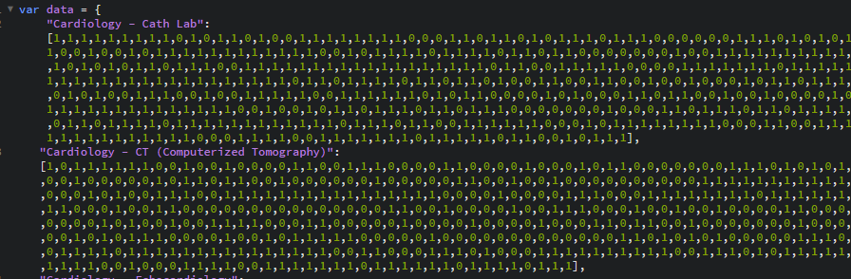
Database Sample

Slide 7
Description of Demo
1. Demo(1) show all the original data. The closer to the center, the more correlate
2. Because the Demo(1) is really unclear to show, Demo(2) show zoom in with high correlate points in which the range of slider R is between 0.058 to 0.14
3. Demo(3) show the change of R value by using the slider, and the most peripheral circle will change it size base on the different value of R
4. In Demo(3), when cursor move to the point, it will show equipment name and accurate correlation number

Slide 8
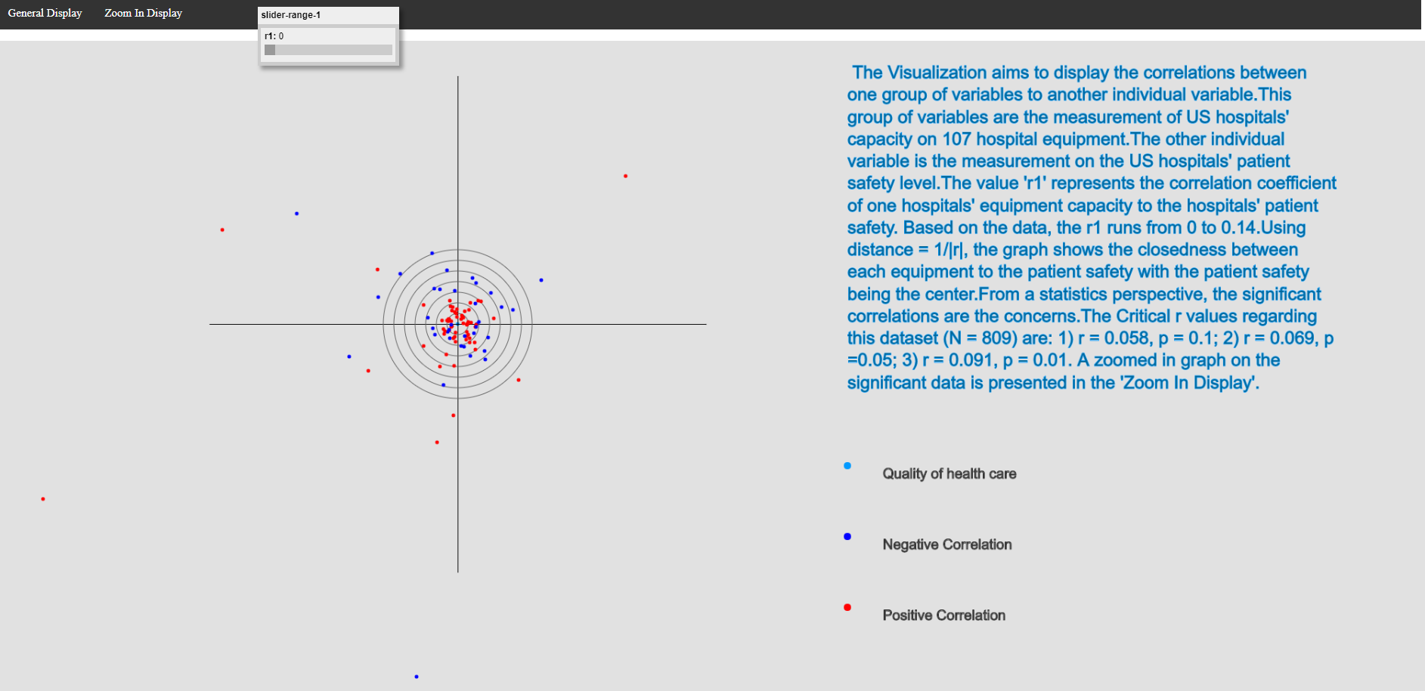
Demo(1)

Slide 9
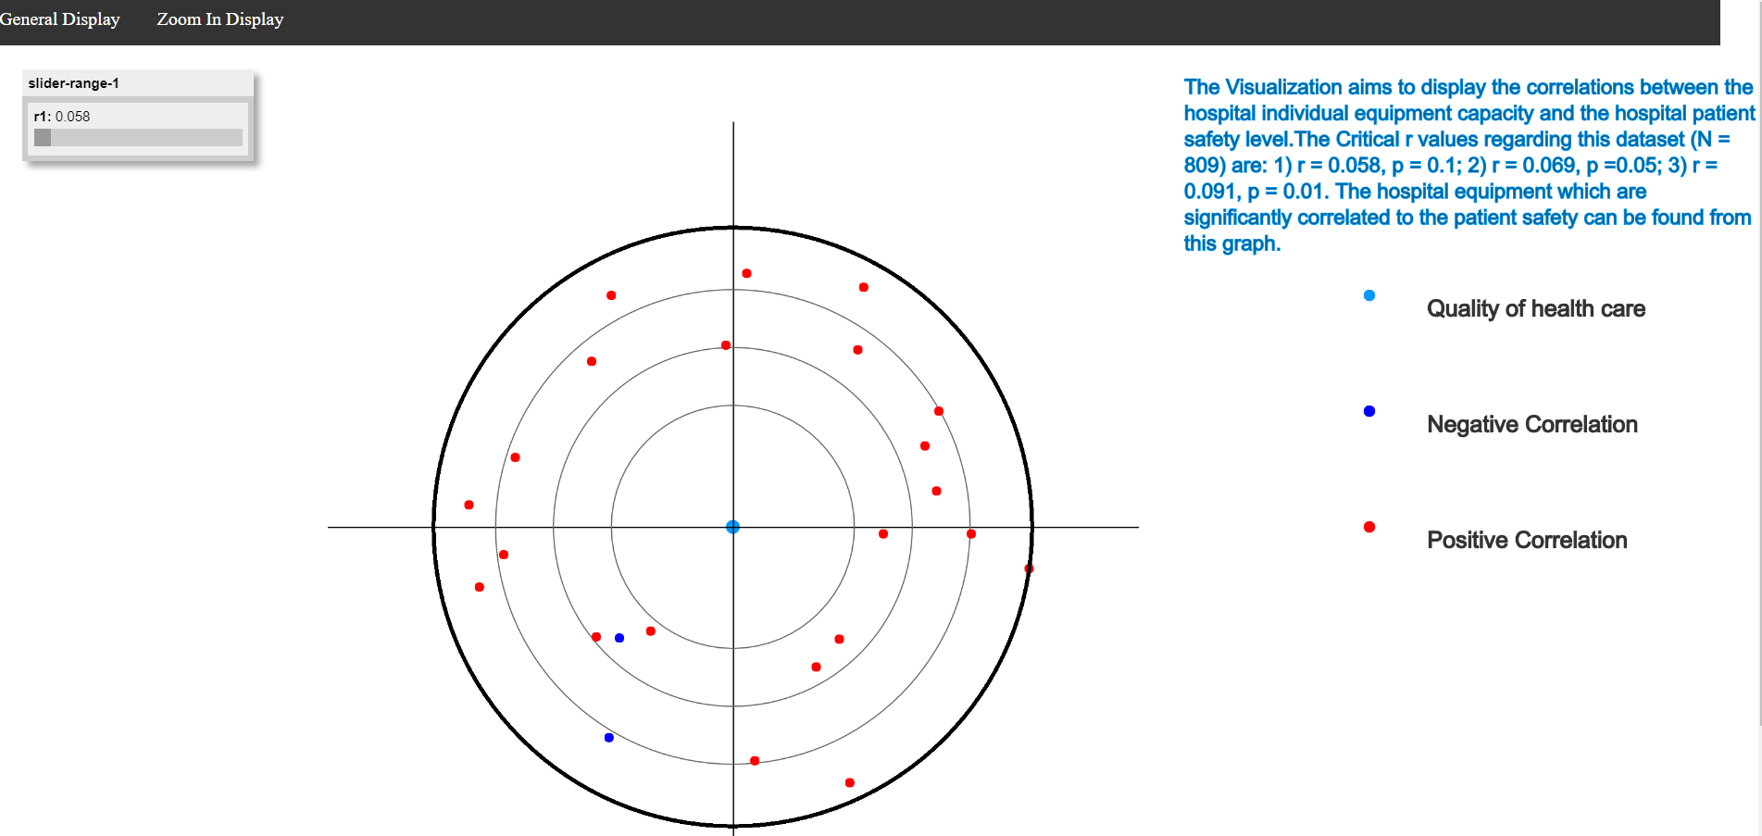
Demo(2)

Slide 10
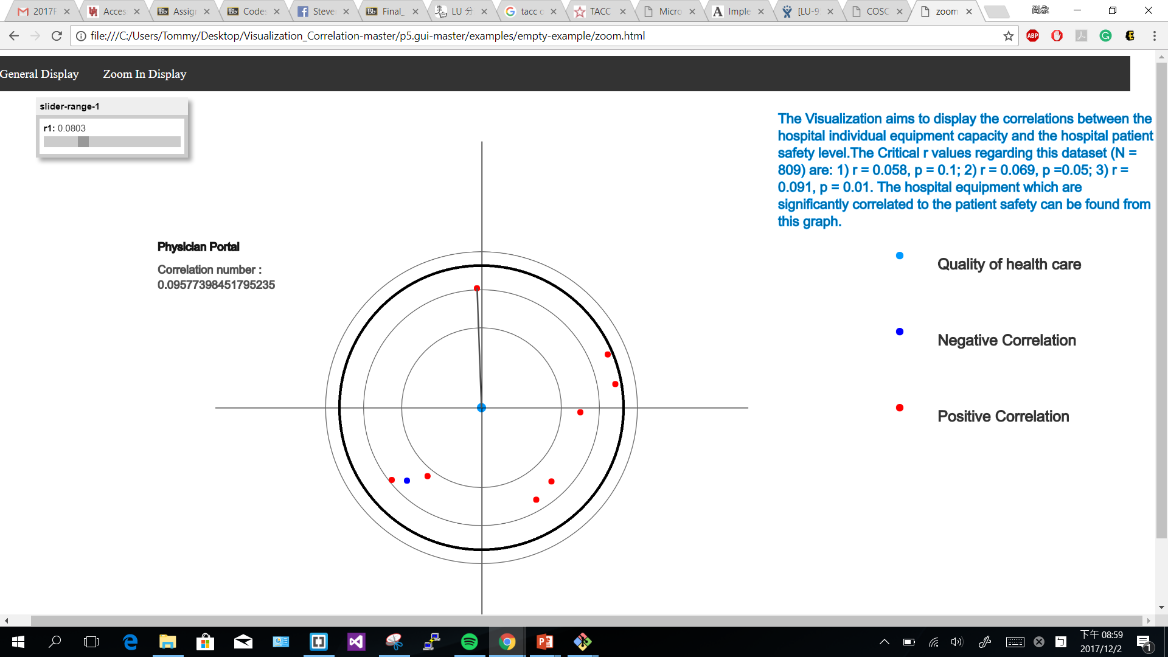
Demo(3)

